Slide 1
Semi-Closed Solutions in a New Model for Yield Curve Attribution
Maria Vieira
Thomson Reuters
maria.vieira@thomsonreuters.com
vieira.maria@gmail.com
Disclaimer: I will be presenting my own ideas, not necessarily the official position of Thomson Reuters.

Slide 2
Motivation
It is empirically observed the returns of investment grade fixed income securities are correlated with yield curve movements.
Yield curve attribution breaks down the return of an investment grade fixed income security into components:
a) related to the yield curve (i.e., treasury returns).
b) intrinsic to the security itself (spread return, paydown return, etc.)

Slide 3
Models out there for YCA:
They are usually based on:
Principal component analysis.
Fitting polynomials to the yield curve.
Empirical (example: using the shift of the 5 year tenor to determine the shift return).

Slide 4
Treasury returns
Usual breakdown:
1) Yield – related to the coupon payments.
2) Roll – rolling down or up in the Yield Curve.
3) Shift – parallel movement of the YC.
4) Twist – bending of the YC.
5) Shape – whatever is not explained by the above.

Slide 5
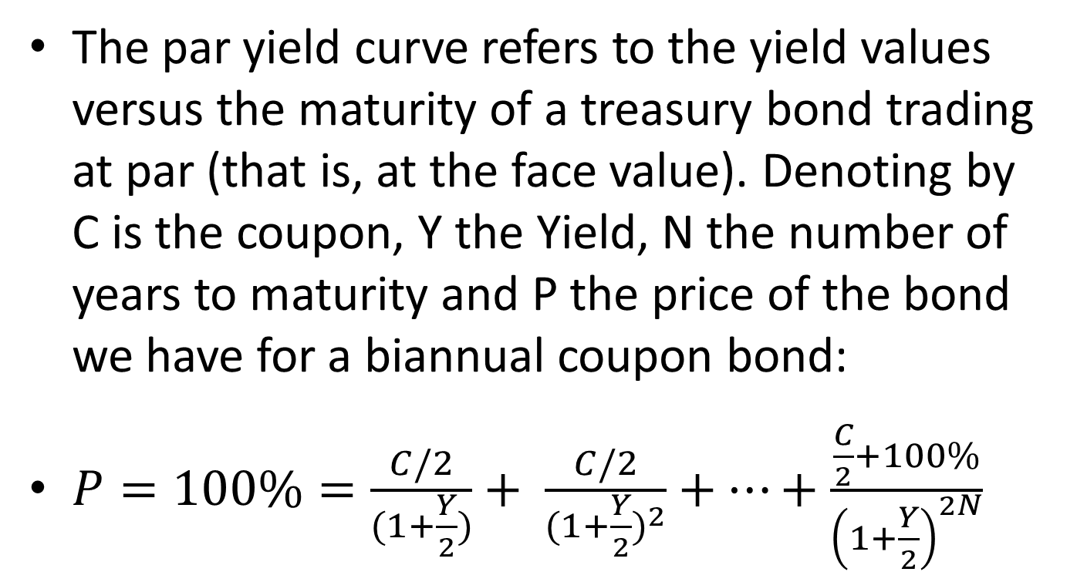
Par Yield Curve
The par yield curve refers to the yield values versus the maturity of a treasury bond trading at par (that is, at the face value). Denoting by C is the coupon, Y the Yield, N the number of years to maturity and P the price of the bond we have for a biannual coupon bond:
$P=100\%=\frac{C/2}{(1+\frac{Y}{2})}+ \frac{C/2}{{(1+\frac{Y}{2})}^{2}}+…+\frac{\frac{C}{2}+100\%}{{\left(1+\frac{Y}{2}\right)}^{2N}}$

Slide 6
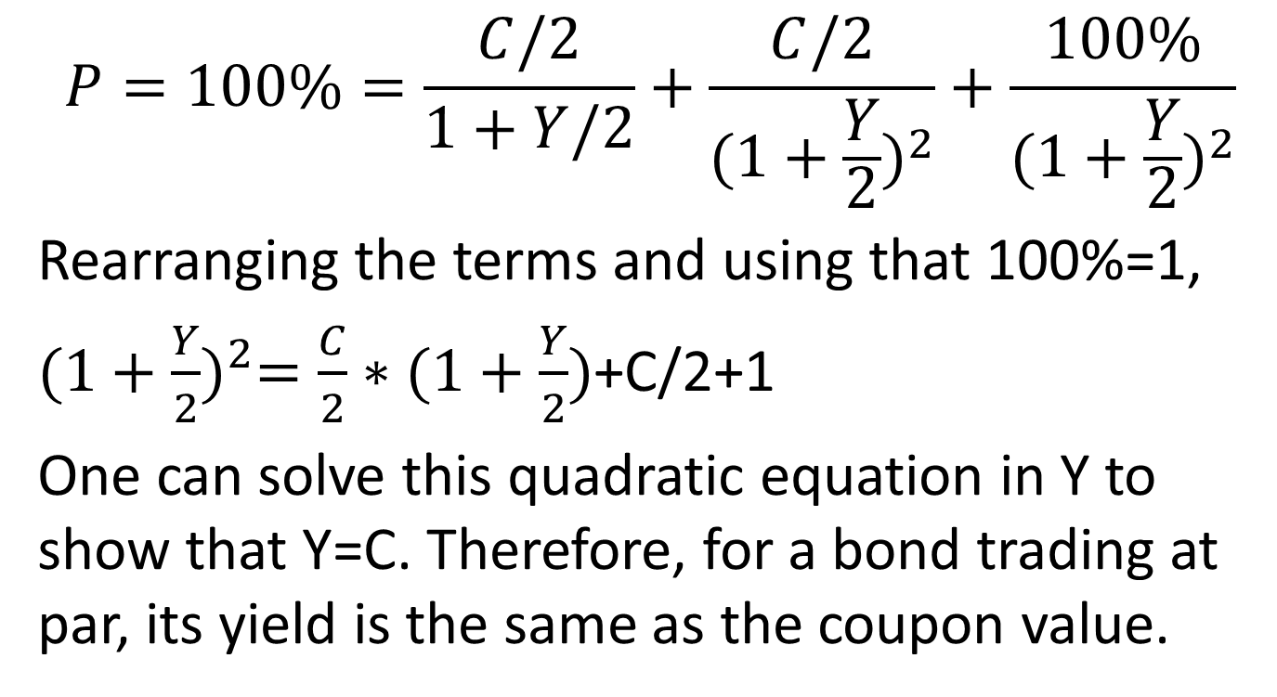
Illustration for a 1-year bond
$$P=100\%=\frac{C/2}{1+Y/2}+\frac{C/2}{{(1+\frac{Y}{2})}^{2}}+\frac{100\%}{{(1+\frac{Y}{2})}^{2}}$$
Rearranging the terms and using that 100%=1,
${(1+\frac{Y}{2})}^{2}=\frac{C}{2}∗(1+\frac{Y}{2})$+C/2+1
One can solve this quadratic equation in Y to show that Y=C. Therefore, for a bond trading at par, its yield is the same as the coupon value.

Slide 7
The US par yield curve
Real US par yield curves for the dates of 8/31/2010 (upper) and 9/30/2010 (lower)
For interpolation purposes,
we divide the YC in
60 tenors, via spline
fitting, separated by
0.5 years. This corresponds
to 60 synthetic treasury
bonds.

Slide 8

The passing of time for a treasury bond:
Yield $Y_{t}$
$$Y_{t+∆t}$$
${Y′}_{}$
i/2-Δt i/2 Maturity
For a 5-year bond, i=10, for a 10-year bond, i=20, etc.

Slide 9
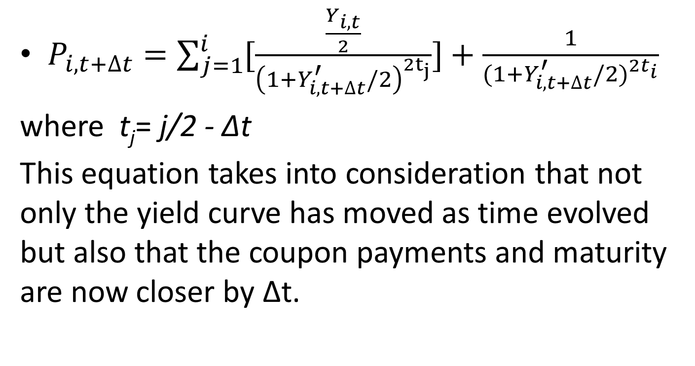
Price of the bond as time passes
$P_{i,t+∆t}=\sum_{j=1}^{i}{[\frac{\frac{Y_{i,t}}{2}}{{\left(1+Y_{i,t+∆t}^{′}/2\right)}^{{2t}_{j}}}]}+\frac{1}{{(1+Y_{i,t+∆t}^{′}/2)}^{{2t}_{i}}}$
where t_{j}= j/2 - ∆t
This equation takes into consideration that not only the yield curve has moved as time evolved but also that the coupon payments and maturity are now closer by ∆t.

Slide 10
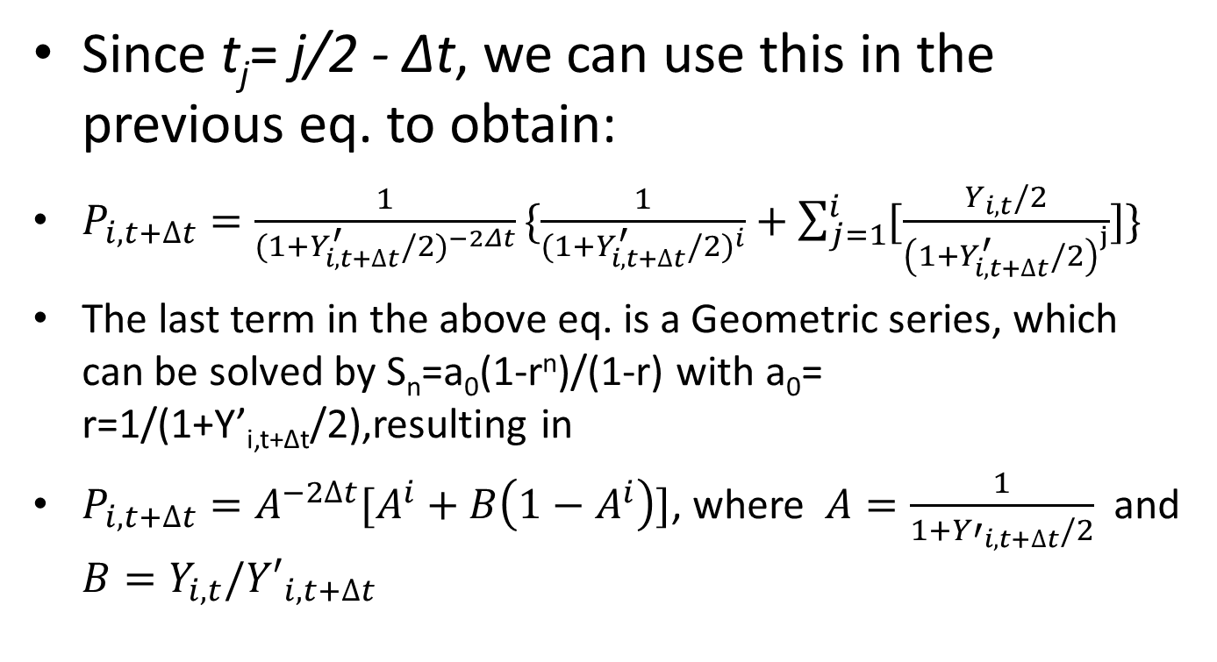
Working out the previous equation:
Since t_{j}= j/2 - ∆t, we can use this in the previous eq. to obtain:
$P_{i,t+∆t}=\frac{1}{{(1+Y_{i,t+∆t}^{′}/2)}^{−2Δt}}\{\frac{1}{{(1+Y_{i,t+∆t}^{′}/2)}^{i}}+\sum_{j=1}^{i}{[\frac{Y_{i,t}/2}{{\left(1+Y_{i,t+∆t}^{′}/2\right)}^{j}}]\}}$
The last term in the above eq. is a Geometric series, which can be solved by S_{n}=a₀(1-r^{n})/(1-r) with a₀= r=1/(1+Y’_{i,t+Δt}/2),resulting in
$P_{i,t+∆t}=A^{−2∆t}[A^{i}+B\left(1−A^{i}\right)]$, where $A=\frac{1}{1+{Y′}_{i,t+∆t}/2}$ and $B=Y_{i,t}/{Y′}_{i,t+∆t}$

Slide 11

Implied return of a treasury bond:
$R_{i}=\left(\frac{P_{i,t+∆t}}{P_{i,t}}−1\right)100\%=( P_{i,t+∆t}$-1)*100% $=\left\{A^{−2∆t}\left[A^{i}+B\left(1−A^{i}\right)\right]−1\right\}∗100\%$
8/31/2010 to
9/30/2010

Slide 12


Breaking down the returns: yield, roll, shift, twist and shape.
Yield and roll, depend on the passage of time, we calculate them first.
Yield return: we fix the yield and vary the time.
Roll return: we fix the time and change the yield.
Yi,t
$$Y_{i,t+∆t}$$
$$Y_{i,t+∆t}^{′}$$

Slide 13
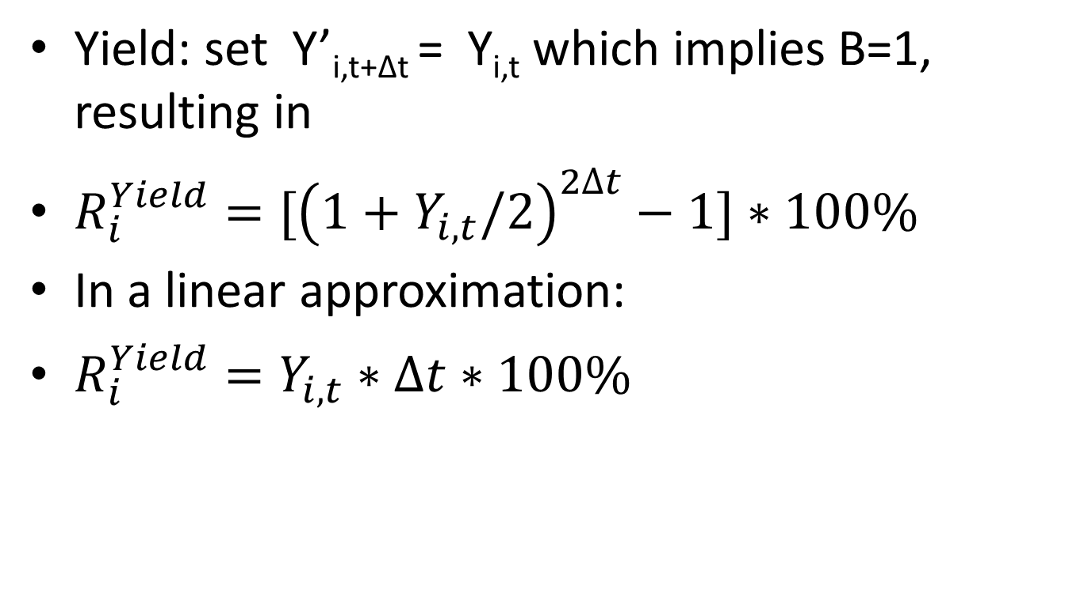
Yield return
Yield: set Y’_{i,t+Δt} = Y_{i,t} which implies B=1, resulting in
$R_{i}^{Yield}=[{\left(1+Y_{i,t}/2\right)}^{2∆t}−1]∗100\%$
In a linear approximation:
$R_{i}^{Yield}=Y_{i,t}∗∆t∗100\%$

Slide 14
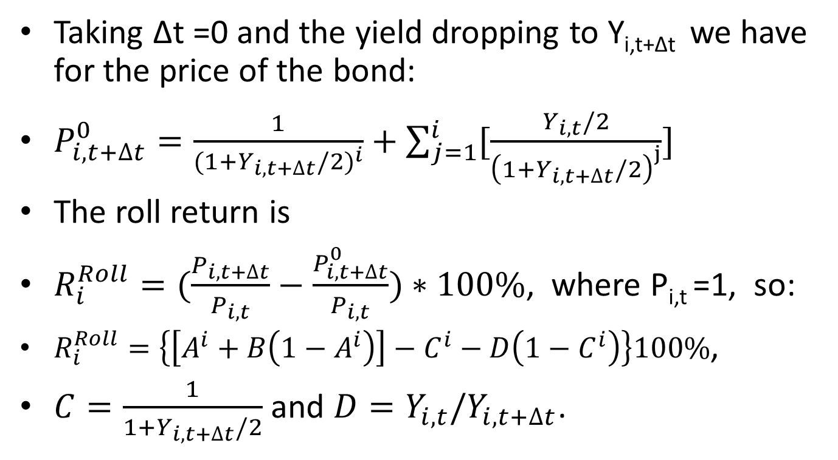
Roll return:
Taking Δt =0 and the yield dropping to Y_{i,t+Δt} we have for the price of the bond:
$P_{i,t+∆t}^{0}=\frac{1}{{(1+Y_{i,t+∆t}/2)}^{i}}+\sum_{j=1}^{i}{[\frac{Y_{i,t}/2}{{\left(1+Y_{i,t+∆t}/2\right)}^{j}}]}$
The roll return is
$R_{i}^{Roll}=(\frac{P_{i,t+∆t}}{P_{i,t}}−\frac{P_{i,t+∆t}^{0}}{P_{i,t}})∗100\%$, where P_{i,t} =1, so:
$R_{i}^{Roll}=\left\{\left[A^{i}+B\left(1−A^{i}\right)\right]−C^{i}−D\left(1−C^{i}\right)\right\}100\%$,
$C=\frac{1}{1+Y_{i,t+∆t}/2}$ and $D=Y_{i,t}/Y_{i,t+∆t}$.

Slide 15
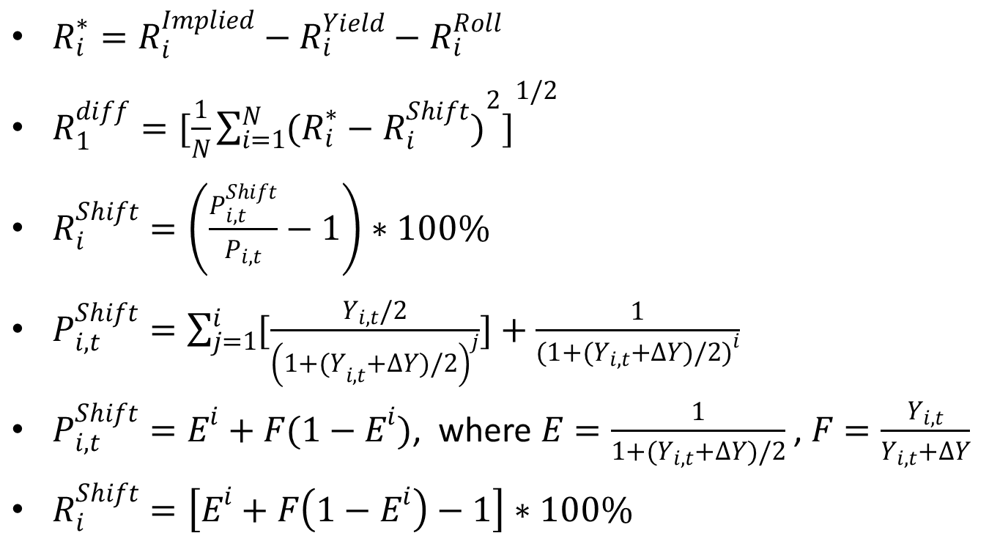
Shift return
$R_{i}^{∗}=R_{i}^{Implied}−R_{i}^{Yield}−R_{i}^{Roll}$
$R_{1}^{diff}={[\frac{1}{N}\sum_{i=1}^{N}{{(R_{i}^{∗}−R_{i}^{Shift})}^{2}}]}^{1/2}$
$R_{i}^{Shift}=\left(\frac{P_{i,t}^{Shift}}{P_{i,t}}−1\right)∗100\%$
$P_{i,t}^{Shift}=\sum_{j=1}^{i}{[\frac{Y_{i,t}/2}{{\left(1+{(Y}_{i,t}+∆Y)/2\right)}^{j}}]}+\frac{1}{{(1+(Y_{i,t}+∆Y)/2)}^{i}}$
$P_{i,t}^{Shift}=E^{i}+F(1−E^{i})$, where $E=\frac{1}{1+(Y_{i,t}+∆Y)/2}$ , $F=\frac{Y_{i,t}}{Y_{i,t}+∆Y}$
$R_{i}^{Shift}=\left[E^{i}+F\left(1−E^{i}\right)−1\right]∗100\%$

Slide 16
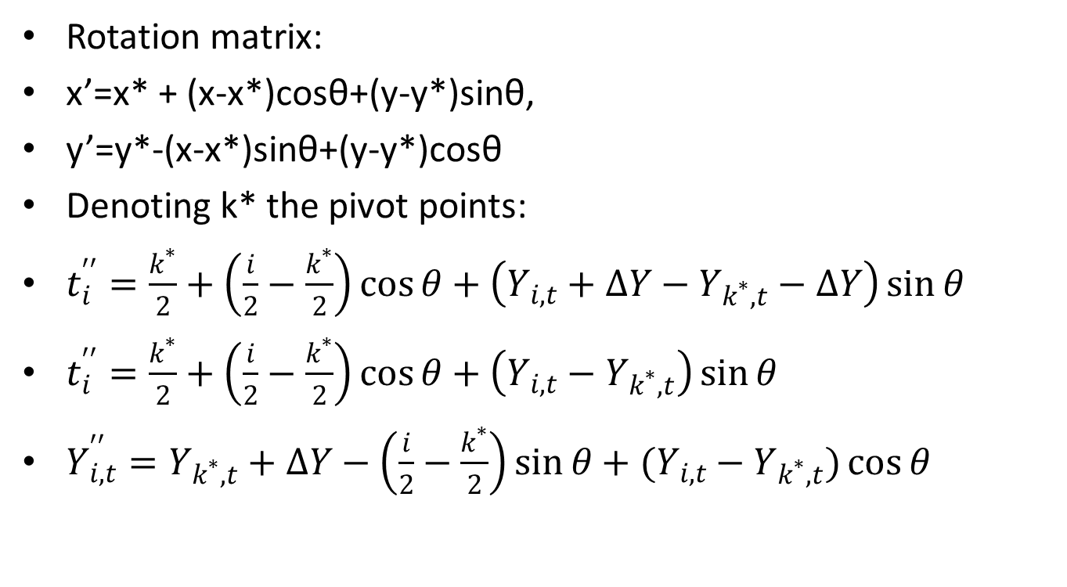
Twist return:
Rotation matrix:
x’=x* + (x-x*)cosθ+(y-y*)sinθ,
y’=y*-(x-x*)sinθ+(y-y*)cosθ
Denoting k* the pivot points:
$t_{i}^{′′}=\frac{k^{∗}}{2}+\left(\frac{i}{2}−\frac{k^{∗}}{2}\right)\cos{θ}+\left(Y_{i,t}+∆Y−Y_{k^{∗},t}−∆Y\right)\sin{θ}$
$t_{i}^{′′}=\frac{k^{∗}}{2}+\left(\frac{i}{2}−\frac{k^{∗}}{2}\right)\cos{θ}+\left(Y_{i,t}−Y_{k^{∗},t}\right)\sin{θ}$
$Y_{i,t}^{′′}=Y_{k^{∗},t}+∆Y−\left(\frac{i}{2}−\frac{k^{∗}}{2}\right)\sin{θ}+(Y_{i,t}−Y_{k^{∗},t})\cos{θ}$

Slide 17
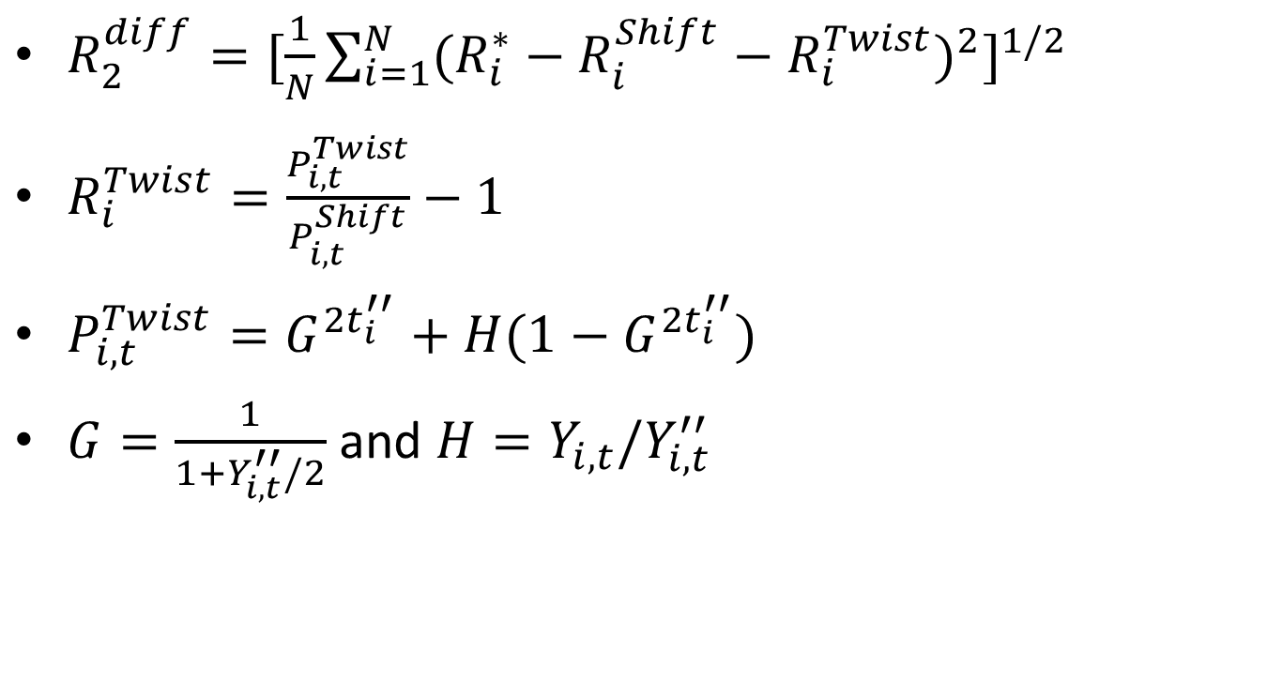
Twist return (cont.)
$R_{2}^{diff}={[\frac{1}{N}\sum_{i=1}^{N}{{(R_{i}^{∗}−R_{i}^{Shift}−R_{i}^{Twist})}^{2}}]}^{1/2}$
$R_{i}^{Twist}=\frac{P_{i,t}^{Twist}}{P_{i,t}^{Shift}}−1$
$P_{i,t}^{Twist}=G^{2t_{i}^{′′}}+H(1−G^{2t_{i}^{′′}})$
$G=\frac{1}{1+Y_{i,t}^{′′}/2}$ and $H=Y_{i,t}/Y_{i,t}^{′′}$

Slide 18
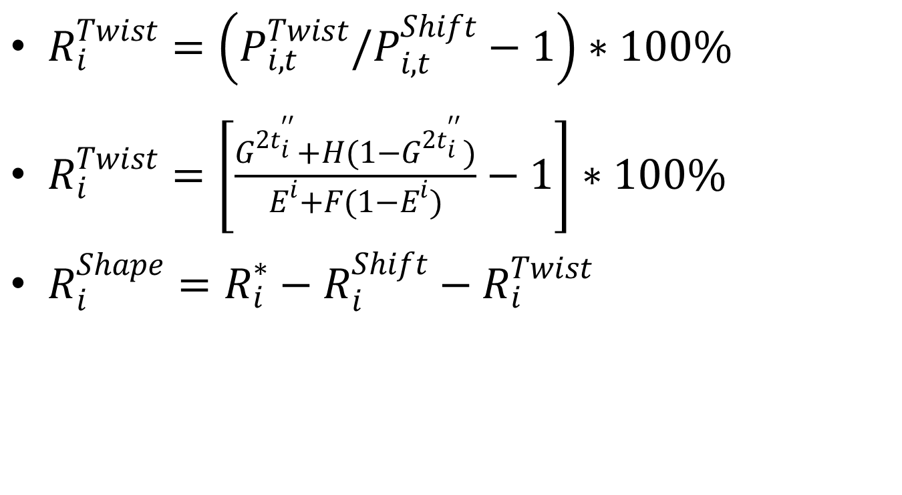
Twist (cont.) and Shape
$R_{i}^{Twist}=\left(P_{i,t}^{Twist}/P_{i,t}^{Shift}−1\right)∗100\%$
$R_{i}^{Twist}=\left[\frac{G^{2t_{i}^{′′}}+H(1−G^{2t_{i}^{′′}})}{E^{i}+F(1−E^{i})}−1\right]∗100\%$
$R_{i}^{Shape}=R_{i}^{∗}−R_{i}^{Shift}−R_{i}^{Twist}$

Slide 19
Yield shift and angle of twist of return difference minimization:
Shift
Twist

Slide 20
Return components as a function of the maturity of the bond
8/31/2010 to
9/30/2010
Yield curves
Implied and actual return
Roll return
Yield return
Twist and
Shape returns
Shift return

Slide 21
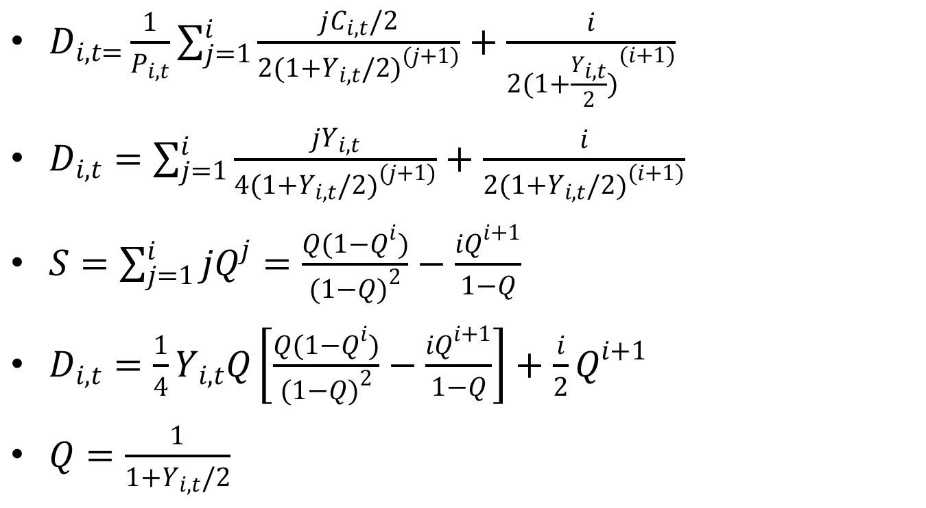
Duration matching approach (Lord 1997)
$D_{i,t=}\frac{1}{P_{i,t}}\sum_{j=1}^{i}{\frac{jC_{i,t}/2}{{2(1+Y_{i,t}/2)}^{(j+1)}}+\frac{i}{{2(1+\frac{Y_{i,t}}{2})}^{(i+1)}}}$
$D_{i,t}=\sum_{j=1}^{i}{\frac{jY_{i,t}}{{4(1+Y_{i,t}/2)}^{(j+1)}}+\frac{i}{2{(1+Y_{i,t}/2)}^{(i+1)}}}$
$S=\sum_{j=1}^{i}{jQ^{j}}=\frac{Q(1−Q^{i})}{{(1−Q)}^{2}}−\frac{iQ^{i+1}}{1−Q}$
$D_{i,t}=\frac{1}{4}Y_{i,t}Q\left[\frac{Q(1−Q^{i})}{{(1−Q)}^{2}}−\frac{iQ^{i+1}}{1−Q}\right]+\frac{i}{2}Q^{i+1}$
$Q=\frac{1}{1+Y_{i,t}/2}$

Slide 22
Returns as a function of the duration
Yield and Roll
Shift
Twist
Shape

Slide 23
Case of a YC mostly rotated (06/30/2008 to 07/31/2008)
Yield curves
Yield and roll return
Shift, twist and shape returns

Slide 24
Case of 06/30/2008 to 07/31/2008 (returns versus duration)

Slide 25
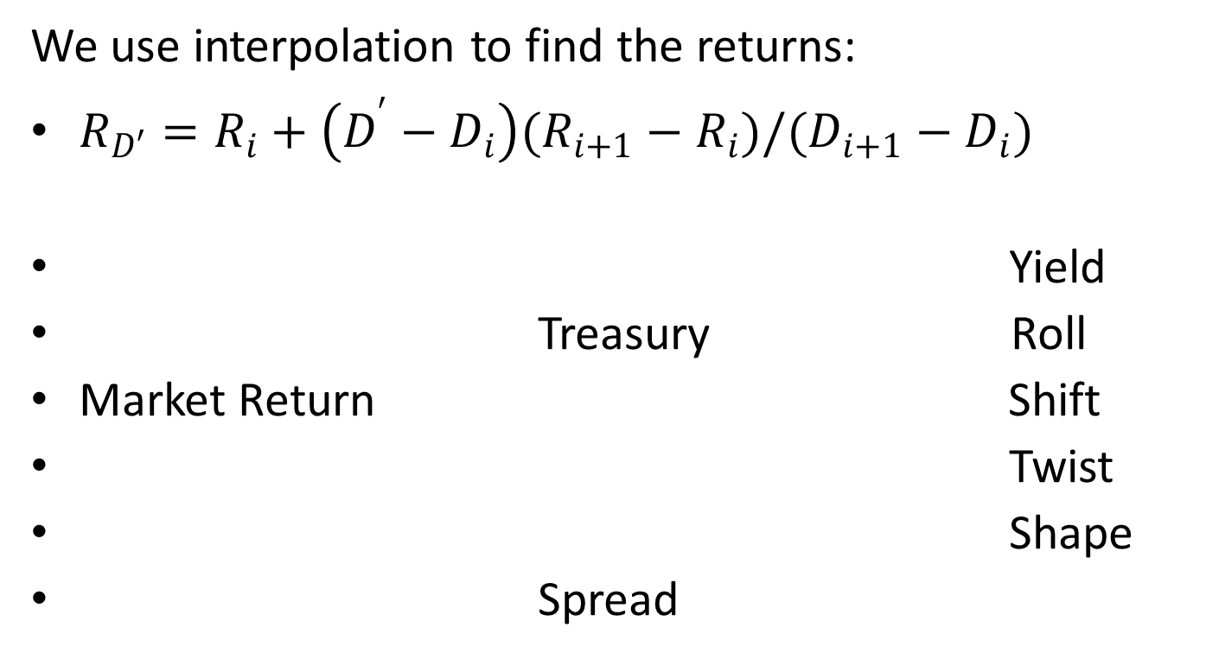
Breakdown of Investment Grade Bonds
We use interpolation to find the returns:
$R_{D′}=R_{i}+\left(D^{′}−D_{i}\right)(R_{i+1}−R_{i})/(D_{i+1}−D_{i})$
Yield
Treasury Roll
Market Return Shift
Twist
Shape
Spread

Slide 26
Example: A corporate bond.
Cusip: 00036AAB (AARP bond).
Beginning date of the period: 07/30/2010
Duration: 11.13 years (Maturity: 20.76 years, yield: 5.93%).
Ending date: 08/31/2010
Market return: 8.63%
Returns using our method:
Yield ret.: 0.29%, roll: 0.08%, shift: 5.56%, twist:
-0.07%, shape: 0.45%, spread: 2.32%

Slide 27
Example: a treasury bond:
Cusip: 912828ND.
Beginning date of the period: 07/30/2010
duration: 8.24 years (maturity: 9.80 years,, yield: 2.90%).
Ending date: 08/31/2010
Market return: 4.014%
Returns using our method:
Yield ret.: 0.242%, roll: 0.109%, shift: 4.081%, twist: -0.082%, shape: -0.172%, spread: 0.16%

Slide 28
Historical Analysis of the US Yield Curve (5 years and entire period)
2008
Solid squares=
Implicit return
X -> yield return
* -> roll return
Empty square= shift ret.
+ -> twist return
Circle -> shape return
2007
2009
2010
2010
2007-2010

Slide 29
Historical analysis: Average values for the returns:
Vertex | 1-year | 2-year | 5-year | 10-year | 30- year
Implied | 0.205 | 0.326 | 0.625 | 0.784 | 1.002
Actual | 0.205 | 0.325 | 0.631 | 0.717 | 0.987
Period | Implied Return | Yield Return | Roll Return | Shift Return | Twist Return | Shape Return
2007 | 0.830 | 0.385 | 0.009 | 0.381 | 0.029 | 0.026
2008 | 1.859 | 0.292 | 0.037 | 1.501 | -0.008 | 0.037
2009 | -1.055 | 0.272 | 0.057 | -1.433 | 0.032 | 0.017
2010 | 0.763 | 0.281 | 0.074 | 0.384 | 0.025 | -0.002
2011 | 1.710 | 0.240 | 0.073 | 1.436 | 0.010 | -0.048
2007-2011 | 0.820 | 0.293 | 0.049 | 0.454 | 0.018 | 0.006
 | Implied Return | Yield Return | Roll Return | Shift Return | Twist Return | Shape Return
2007-2011 | 100% | 36% | 6% | 55% | 2% | 1%

Slide 30
Advantages of our method:
Unlike PCA, returns depend only on the yield curves of the period into consideration.
Unlike other empirical methods, it is built to minimize spurious returns of treasury securities.
Unlike polynomial methods, works in maximizing the shift and twist returns, which we consider a first and second approximation to the treasury returns.

Slide 31
Publications:
The work presented here appeared in two publications:
1) M. de Sousa Vieira, “A New Empirical Model for Yield Curve Attribution”, Journal of Performance Measurement, Summer 2011.
2) M. de Sousa Vieira, “Semi-Closed Solutions in Yield Curve Attribution”, Journal of Performance Measurement, Spring 2013.

Slide 32
Thank you very much for your attention!

